Slide 1
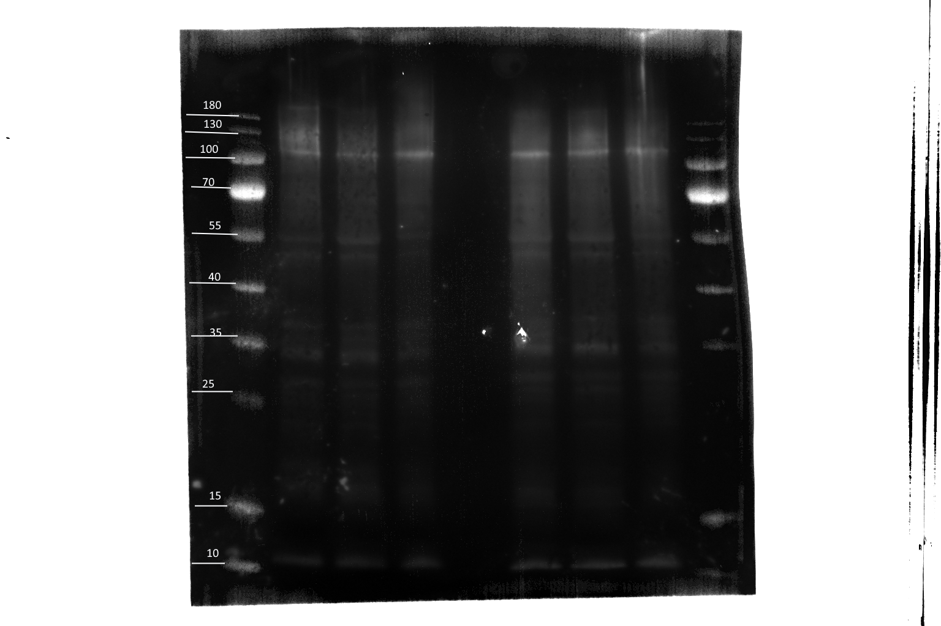
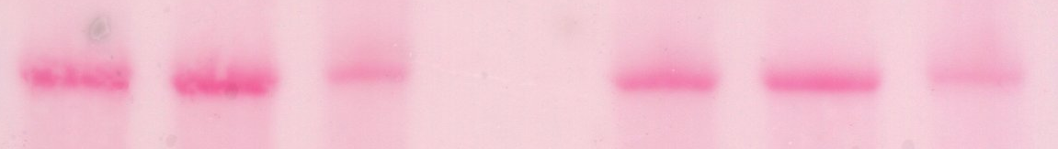
Glycosyrin
Empty Vector
Mw
(kDa)
~180
~130
~100
~70
~55
~40
~35
~25
~15
~10
RCAI Lectin.
Ponceau.
~55

Slide 2
Glycosyrin
Empty Vector
Mw
(kDa)
~180
~130
~100
~70
~55
~40
~35
~25
~15
~10
~55

Slide 4
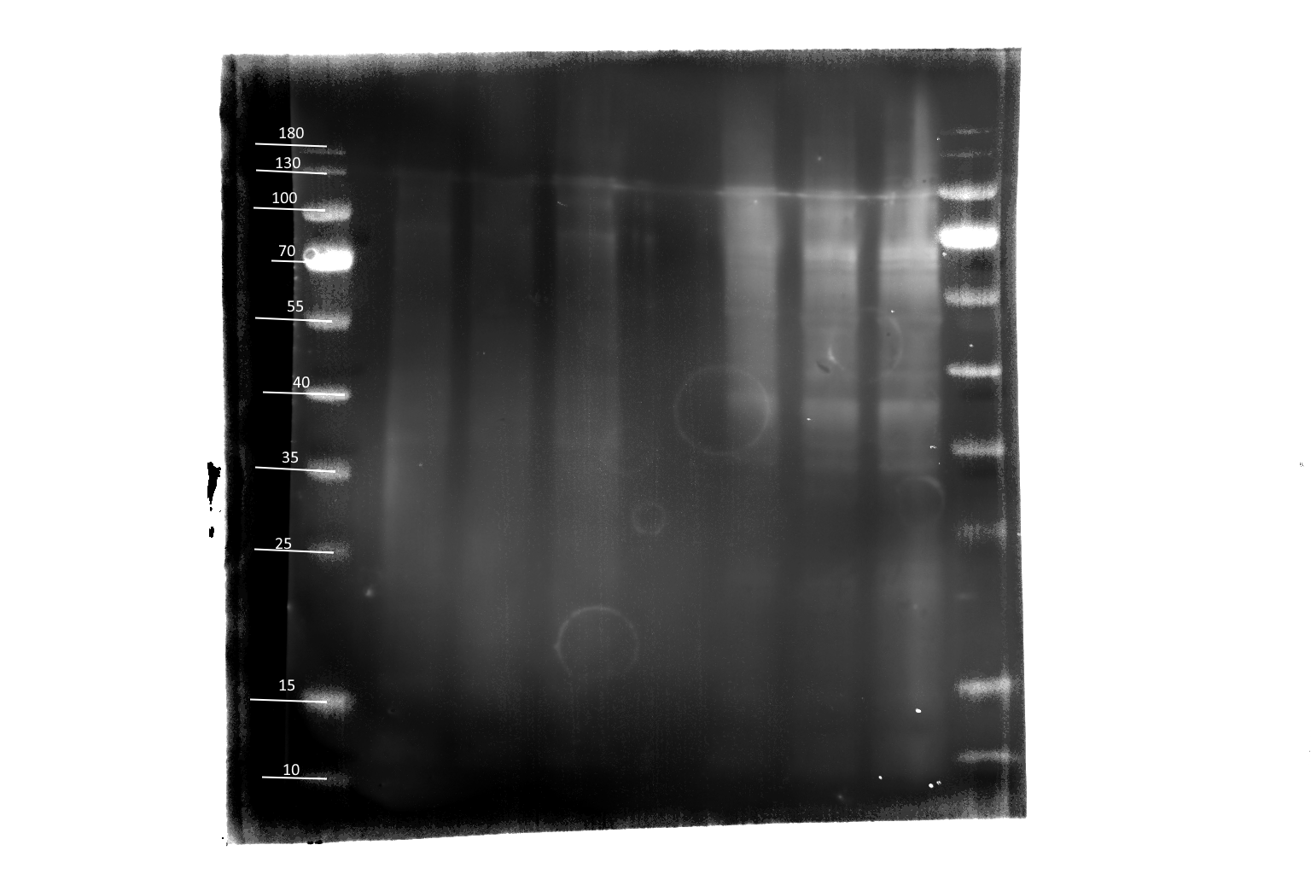
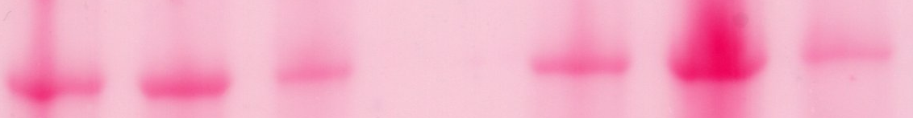
Glycosyrin.
Empty Vector.
Mw
(kDa)
~130
~100
~70
~55
~40
~35
ConA Lectin.
Ponceau.
~55

Slide 5
Glycosyrin.
Empty Vector.
Mw
(kDa)
~130
~100
~70
~55
~40
~35
~55

Slide 9
Background: what to put on the poster.
Glycosyrin is an iminosugar inhibitor of plant glycosidases, and is encoded by the gsn biosynthesis cluster.
Though involved in other plant-pathogen systems, the roles of glycosyrin have primarily been studied in the Nicotiana benthamiana-Pseudomonas syringae plant-pathogen system, in which it inhibits the β-galactosidase BGAL1.
Glycosyrin could be inspire therapies to treat human diseases.

Slide 10
Background: what to say.
Glycosyrin is an iminosugar inhibitor of plant glycosidases, and is encoded by the gsn biosynthesis cluster of five genes. This means that Agrobacterium containing the gsn cluster in its T-DNA can produce glycosyrin, when infiltrated into the apoplast.
Though involved in other plant-pathogen systems, the roles of glycosyrin have primarily been studied in the Nicotiana benthamiana-Pseudomonas syringae plant-pathogen system, in which it inhibits the β-galactosidase BGAL1.
BGAL1 aids proteases in releasing flg22 peptides from flagellin to initiate Pattern Triggered Immunity (PTI), so understanding how glycosyrin inhibits glycosidases is critical from a plant immunity perspective.
Additionally, glycosyrin can cause a build-up of osmolytes, such as trehalose, by inhibiting other glycosidases.
Glycosyrin also poses exciting possibilities for human health as other iminosugars have been used to treat diseases, such as Type II diabetes, so glycosyrin could be used in the development of new therapies.

Slide 11
Aims and objectives: what to put on the poster.
To examine the impact of glycosyrin on the glycosylation of the apoplastic proteome of Nictotiana benthamiana.
Western blots of the apoplastic proteome using two different lectins ConA and RCAI.
Comparing the fluorescence in leaf samples infiltrated with either the empty vector or glycosyrin and then later FDG.
H0: no significant difference in lectin binding or FDG levels between glycosyrin and the controls.
HA: significantly increased lectin binding, but decreased FDG levels, in glycosyrin-treated samples relative to the controls.

Slide 12
Aims and objectives: what to say.
The primary objective of this experiment was to examine the impact of glycosyrin on the glycosylation of the apoplastic proteome of Nictotiana benthamiana.
I aimed to do this through two experiments.
Firstly, a Western blot of protein extracts from the apoplast of leaf samples infiltrated with Agrobacterium containing either an empty vector or the gsn cluster using two different lectins Concavalin A (ConA) and Ricinus communis agglutinin (RCAI).
2. Comparing the fluorescence in leaf samples infiltrated with either the empty vector or glycosyrin and a specific fluorescent protein Fluorescein di-β-D-galactopyranoside, hereafter FDG.
H0: no significant difference in lectin binding or FDG levels between glycosyrin and the controls.
HA: significantly increased lectin binding, but decreased FDG levels, in glycosyrin-treated samples relative to the controls.

Slide 13
Methodology: what to say.
Inoculation:
Practice aseptic technique inside a biosafety cabinet.
Add bacteria to a selective growth media containing rifampicin and tetracycline.
Use two different strains of Agrobacterium: aNS33 empty vector (EV) strain and aNS37 strain, containing the gsn cluster.
Agroinfiltration:
Infiltrate two whole leaves of three plants using EV bacterial cultures. Infiltrate two whole leaves of three plants using gsn bacterial cultures. These six plants will be used for the lectin blot.
Infiltrate a further three plants (two leaves on each) to use later with the FDG probe. Infiltrate a large spot of EV on one side of each leaf and a large spot of gsn on the other side of each leaf. This paired design reduces extraneous variation that would arise due to difference between plants.
Typically, leaves 6 and 7 on a given plant are selected for agroinfiltration, counting from the bottom up.
Leave the agroinfiltrated plants in trays under the lights for three days. Analysis occurs three days post-infiltration, instead of the typical five, because there is no transient expression required-- glycosyrin is produced in the apoplast by Agrobacterium (to simulate a plant pathogen) rather than transiently expressed in the plant.
Apoplastic Fluid Extraction
Extract the apoplastic fluid from two leaves at a time from the six plants that have undergone whole-leaf infiltration to be used in the lectin blots.
Do this by rinsing and rolling the leaves, then filling the mesophyll with water by covering the tip of a 50 ml syringe containing the leaves and de-ionised water, and pushing the plunger.
Remove the leaves, and centrifuge them at 4°C, 500xg and acceleration of 4 for 20 minutes.
The apoplastic fluid is extracted rather than the intracellular proteins because glycosylated proteins tend to be secreted into the apoplast, and this is where glycosyrin is being produced.

Slide 14
Lectin Blotting
Precipitate the proteins by inverting the six tubes of apoplastic fluid with NaCl and acetone, then leaving the tubes on ice for 15 minutes.
Centrifuge the tubes at 12,000xg for 10 minutes, remove the supernatant and add loading buffer.
Heat the tubes on a heat block at 95 °C for five minutes.
Carry out gel electrophoresis: load lanes 1 and 9 with PageRuler Prestained Protein Ladder, lanes 2-4 with EV and lanes 6-8 with glycosyrin-treated samples. Lane 5 is left empty. Repeat this for another gel as there are two different lectins.
Transfer to two PDVF membranes.
Add the membranes to the blocking buffer, then place on an orbital shaker.
Place each membrane in a petri dish, and add either RCAI or ConA (in PBS) to each.
Place the petri dishes in an orbital shaker in a cold room overnight.
Wash with PBS-T.
Cover the membranes in the Strepavidin-HRP + BSA (Bovine Serum Albumin) + PBS-T solution, and place them on the gel shaker for 30 minutes. BSA is used for blocking. The biotin-specific Strepavidin antibody binds to RCAI as RCAI is a biotinylated lectin.
Wash with PBS-T.
Add 1ml of luminol-hydrogen peroxide mixture to each membrane.
Detect chemiluminescence using an ImageQuant LAS400 scanner. Use ImageJ to measure band intensity.
Rinse the membranes in sterile water. Cover the membranes in Ponceau solution, and leave to stain until distinct red bands appear.
Scan the membranes using an Epson scanner.
FDG Assay
Agroinfiltrate a smaller spot of FDG within each spot of EV and gsn on each leaf. These are the negative control and treatment respectively.
Infiltrate FDG in an additional spot on the leaf that had not previously been infiltrated. This is the positive control.
Place the leaves on the Typhoon5 biomolecular imager, and scan at 488nm.
Measure the fluorescence using ImageJ.

Slide 15
Day 1
Day 2
Day 5
Day 6
1. Inoculation.
2. Agroinfiltration.
3. Apoplastic Fluid Extraction.
6. Lectin Blotting Continued.
4. FDG Assay.
5. Lectin Blotting.

Slide 16
1. Inoculation.
2. Agroinfiltration.
3. Apoplastic Fluid Extraction.
4. FDG Assay.
5. Lectin Blotting.
Day 1
Day 2
Day 5
Day 5
Day 5 & 6

Slide 17
Results: put this under the graph or FDG fluorescence image.
FDG Assay:
The data met the assumptions of normality, but not equal variances.
ANOVA with just group (i.e., EV, Gsn or FDG alone): F-statistic: 5.922, p-value: 0.01625; R^2 = 0.4967.
ANOVA with group + plant: F-statistic: 6.562, p-value: 0.009135; R^2 = 0.8311.
In the Tukey test, the p-value between FDG and empty vector was 0.9957075.
The p-values between glycosyrin and FDG was 0.0311179 and glycosyrin and empty vector was 0.0265710.

Slide 18
Blot | Normality (p-value of the Shapiro-Wilk tests) | Homogeneity of Variance (F-test results) | t-value | p-value of the two-sample t-test
ConA (above 30kDa) | 0.2455 (EV) 0.9803 (Gsn) | F = 0.41837 p-value = 0.5899 | -8.8253 | 0.0009098
RCAI (whole lanes) | 0.3907 (EV) 0.3318 (Gsn) | F = 0.01527 p-value = 0.03008 | -1.6853 | 0.2303
RCAI (above 25 kDa) | 0.7768 (EV) 0.3433 (Gsn) | F = 0.033359 p-value = 0.06456 | -1.7861 | 0.1486
RCAI (above 50 kDa) | p= 0.9139 (EV) p = 0.1921 (Gsn) | F = 0.16225 p-value = 0.2792 | -2.4768 | 0.06845
ConA Ponceau | 0.6687 (EV) 0.9015 (Gsn) | F = 2.2813 p-value = 0.6095 | 0.2893 | 0.7867
RCAI Ponceau | 0.5915 (EV) 0.1931 (Gsn) | F = 1.3495 p-value = 0.8513 | 2.7923 | 0.0492
For all of the Western blots, the assumption of normality was met as the p-values for the Shapiro Wilk test all exceeded 0.05.
The assumptions of homogeneity of variance were met for all the blots, except RCAI when using the whole lanes, so I used Welch’s t-test instead.
I used a two-sample t-test to ensure equal protein loading across the control and glycosyrin lanes.
For ConA, there was no significant difference in the level of protein loading between the empty vector and the glycosyrin lanes.
The p-value of the t-test for the RCAI Ponceau was just slightly less than 0.05 (significant difference in the level of protein loading), however, this result is not particularly concerning as 0.05 is an arbitrary threshold, and this result could be due to the small puncture in the gel.
When measuring three rows spread throughout the gel, avoiding the puncture, there was no significant difference in protein loading in the RCAI blot.
Stuff to say:

Slide 19
Discussion: what to actually put on the poster.
Fluorescence was significantly lower in glycosyrin-infiltrated leaf sections than with FDG alone or sections infiltrated with the empty vector, indicating glycosyrin can inhibit galactosidases.
However, there was lots of variation in each group.
There was not a significant difference in the level of RCAI binding between the control and the glycosyrin samples, though the p-value was lower when higher molecular weight proteins were considered.
Perhaps a difference in RCAI binding could be detected by replicating the experiment with a higher power, or glycosyrin only inhibits specific galactosidases.
There was a significant difference in ConA binding between the control and glycosyrin treatment, indicating glycosyrin can inhibit mannosidases and/or glucosidases.
Limitations: more plants and more time to replicate the experiment, and one of the six leaves for the FDG assay was damaged, so unusable.

Slide 20
Discussion: FDG script.
Fluorescence, and hence galactosidase activity, significantly lower in glycosyrin-infiltrated leaf sections than with FDG alone or sections infiltrated with the empty vector. FDG only fluoresces when the galactose residues are cleaved off as this releases its fluorescent group (fluorescein), so this indicates that glycosyrin can inhibit galactosidases as FDG was not cleaved.
Although the Bartlett’s test indicated unequal variances between the different groups in the FDG assay, the sample sizes were all equal, so the test should still be robust to these differences in variances, and the sample sizes were small, so it was appropriate to still use pooled standard deviation in the pairwise t-test.
I believe the unequal variances can be at least partially attributed to differences between plants as when the plant from which each sample was taken was added as an explanatory variable in the ANOVA linear model alongside the treatment groups, over 80% of the variation between samples in fluorescence was explained (as R^2 = 0.8311). The different sizes of the plants, different ages of the leaves and damage to the leaves are all confounding factors that could generate variation between samples. Damage to the leaf due to wounding in agroinfiltration could also play a role in creating variation.

Slide 21
Discussion: lectin script.
In addition, I conducted two lectin blots using a mannose- and glucose-binding lectin (ConA) and a galactose-binding lectin (RCAI) to investigate the broader effects of glycosyrin on the apoplastic proteome.
There was not a significant difference in the level of RCAI binding between the control and the glycosyrin samples. This could be due to differences in protein loading, or damage to the leaves, so fewer proteins were produced, which would result in a weaker signal.
However, the p-value was increasingly lower when higher molecular weight proteins were considered, perhaps indicating a biologically significant difference, even if it were not statistically significant. I would suggest replicating the experiment, but using larger sample sizes, e.g., three leaves instead of two per sample, and more plants, which would provide a greater statistical power to detect the difference in RCAI binding.
RCAI is specific to galactose residues, and the results from the FDG experiment indicates that glycosyrin is capable of inhibiting galactosidases, so this (coupled with the lower p-values for higher molecular weight proteins) could perhaps imply that glycosyrin targets specific galactosidases, or a subset of galactosidases. This could be an interesting avenue for future research because understanding why glycosyrin targets some galactosidases, but not others, could be useful in designing a decoy enzyme for which glycosyrin has a higher affinity than for BGAL1 to undermine the impact of the inhibitor.
For the ConA lectin blot, I considered proteins above 50kDa because there was a clear difference in the level of lectin binding between the empty vector control and glycosyrin upon visual inspection, and the difference in ConA binding was significant at the 0.1% level.
ConA is specific to mannose and glucose, so this means glycosyrin inhibits either one or both of glucosidases and mannosidases because the glucose and/or mannose residues were not removed from the apoplastic proteins.
This presents clear pathways for future research, namely using more specific lectins to distinguish between the impact of glycosyrin on mannosidases and glucosidases, and investigating glycosyrin’s effect on specific proteins, particularly those of a higher molecular weight.

Slide 22
Future Directions: what to put on the poster.
Determining whether glycosyrin can enter cells and inhibit mannosidases using the Galanthus nivalis lectin.
Is there a correlation between glycan variation and inhibitor production?
Compare the impact of glycosyrin on the proteomes of other plants.
Investigate human-infecting pathogens for similar inhibitors.
Developing a decoy enzyme for which glycosyrin has a higher affinity than for BGAL1.
Future Directions: what to say.
This presents clear pathways for future research, namely using more specific lectins to distinguish between the impact of glycosyrin on mannosidases and glucosidases, and investigating glycosyrin’s effect on specific proteins.
The Galanthus nivalis lectin (Gnl) is specific to mannose, unlike ConA, which binds to mannose and glucose residues. As mannosidases are only found inside the cell, Gnl can be used to determine whether glycosyrin can enter cells.
I believe it is likely that glycosyrin enters the cell as GsnE encodes an MSF family transporter, but understanding exactly how glycosyrin crosses the cell membrane, if indeed it does, is crucial as the impact of glycosyrin could be reduced by blocking its mechanism of entry, if transporter proteins are used.
Pseudomonas syringae also varies its glycans on flagellin to evade BGAL1, which is specific to terminal modified Viosamine, so perhaps variation in glycosylation of PAMPs and iminosugar production are correlated as plant glycosidases present a strong selection pressure. Thus, I would first suggest investigating this correlation in different pathogens, beyond Pseudomonas syringae. Furthermore, Schroeder, F (2025) asserts that similar inhibitors of glycosidases could be produced by human-infecting pathogens, so if this correlation holds, I would recommend examining the genomes of pathogens that also vary their glycans to evade the human immune system for clusters similar to the Gsn cluster.

Slide 23
Conclusion
Glycosyrin can inhibit either or both of glucosidases and mannosidases as well as at least some galactosidases to transform the glycosylation of the apoplastic proteome, which is vital to understand from a plant immunity perspective.
There remain many unanswered questions, such as whether glycosyrin impacts the glycosylation of the intracellular proteome, and how glycosyrin impacts the proteomes of different plant species.
Navigating these pathways for future research is imperative in order to map the diverse roles of glycosyrin across various plant-pathogen systems.

